Slide 1
OSDU Concepts Demystifying OSDU

Slide 2
Concepts
What is an OSDU instance?

Slide 3
Concepts
APIS - core services, DDMS, ref +++, husk at search gir annet resultat enn storage
Concept of schema and WKS and Kind → data concept
Master data and ref data
Entitlements -> group-types (user, service, data; herunder acl) + governance, e.g. built in groups and custom, connection with IDP
Legal Tag – requirement, explain built in functionality, governance
Ingestion and consumption
Search/index er på plass
Versjonering er på plass
Namespace → system of engagement
Lineage provenance. Se tech assurance… stole på data
Existence kind…
Technical assurance

Slide 4
What is an OSDU instance?

Slide 5
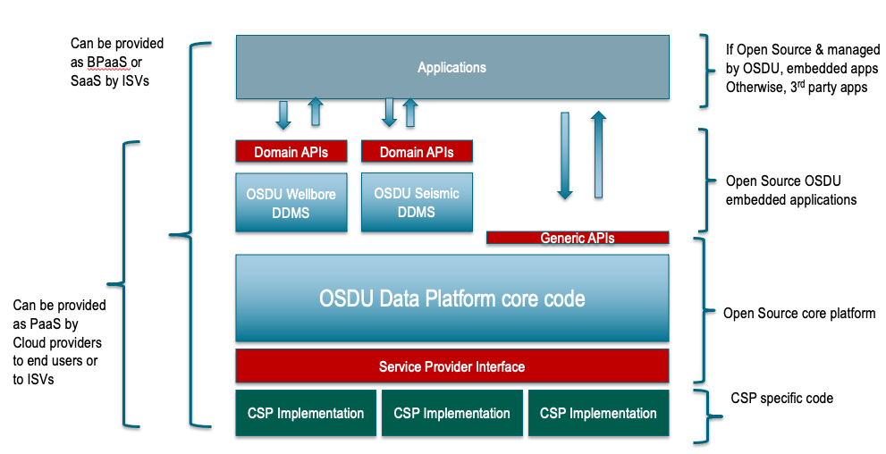
OSDU Data Platform Software Components

Slide 6
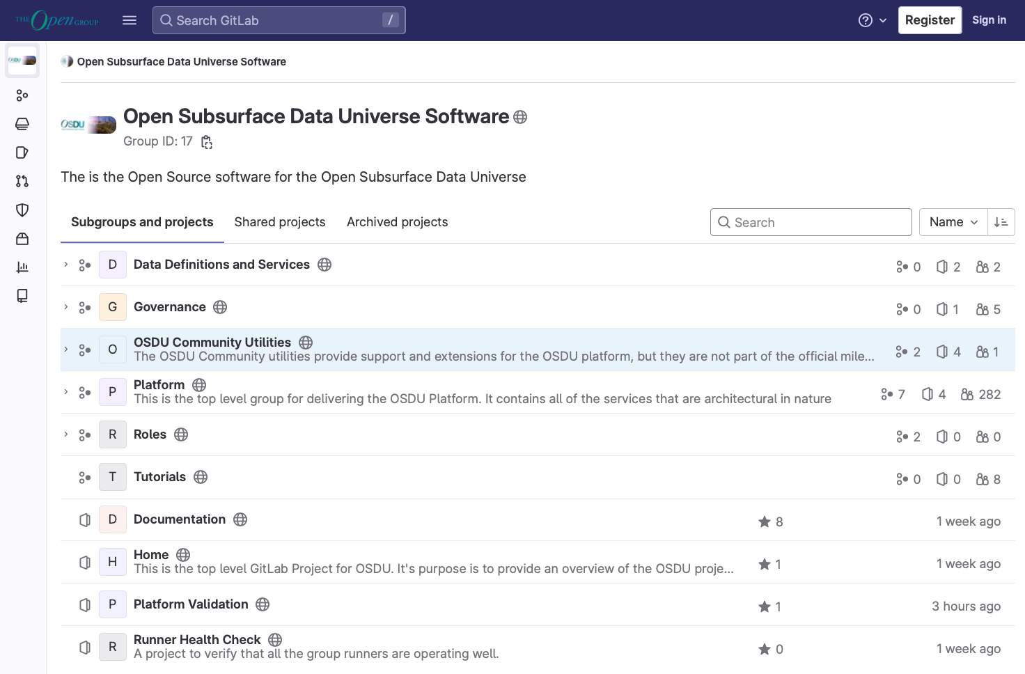
The code…
Platform Code

Slide 7
Demo
Where is the code?
Versioning
Platform Code

Slide 8




Cloud Agnostic

Slide 9
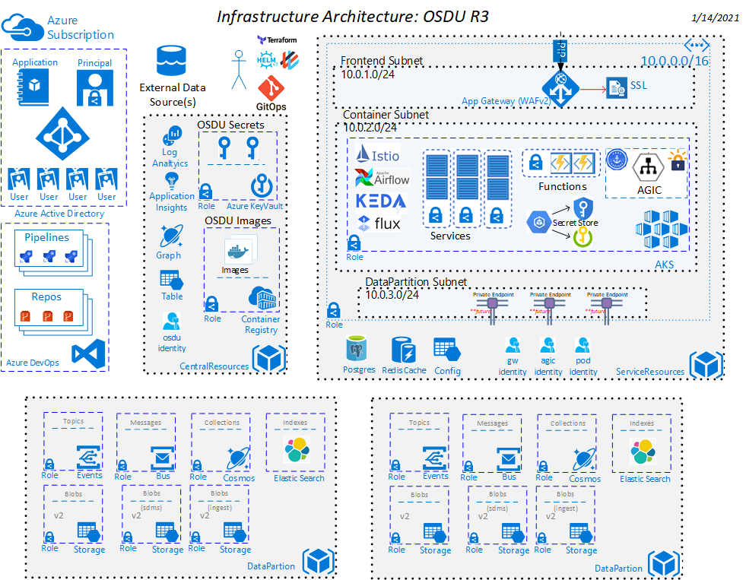
OSDU Behind the scenes

Slide 10
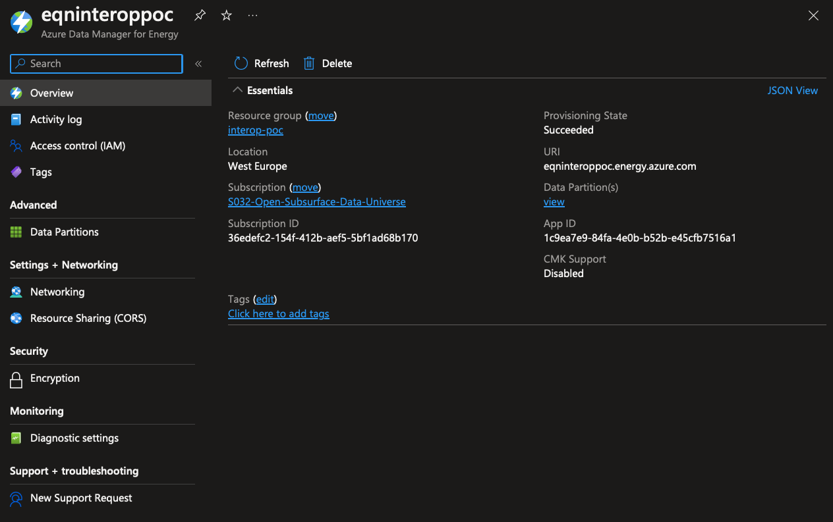
ADME

Slide 11
How can I communicate with my OSDU?

Slide 12
OSDU Data Platform Software Components

Slide 13
APIs only! (for now…?)

Slide 14
Where and how is my data stored?

Slide 15
Two main storages
Catalog
Archive

Slide 16
Two main storages
Catalog
Archive
DocumentDB
BinaryStore

Slide 17
Two main storages
Catalog
Archive
DocumentDB
BinaryStore
JSON
Binaries

Slide 18
Two main storages
File API
Storage API
Dataset API
Catalog
Archive
DocumentDB
BinaryStore
JSON
Binaries

Slide 19
…”main storages…”?

Slide 20
Two main storages
Catalog
Archive

Slide 21
DDMS optimized storage
Wellbore
DDMS
Seismic
DDMS
Catalog
Archive

Slide 22
Well Known Schemas aka WKS

Slide 23
Data structures
File API
Storage API
Dataset API
Catalog
Archive
DocumentDB
BinaryStore
JSON
Binaries

Slide 24
Data structures
Main data types
Master Data
Work Product Components
Reference Data
Work Product
Dataset
Storage API
Catalog
DocumentDB
JSON

Slide 25
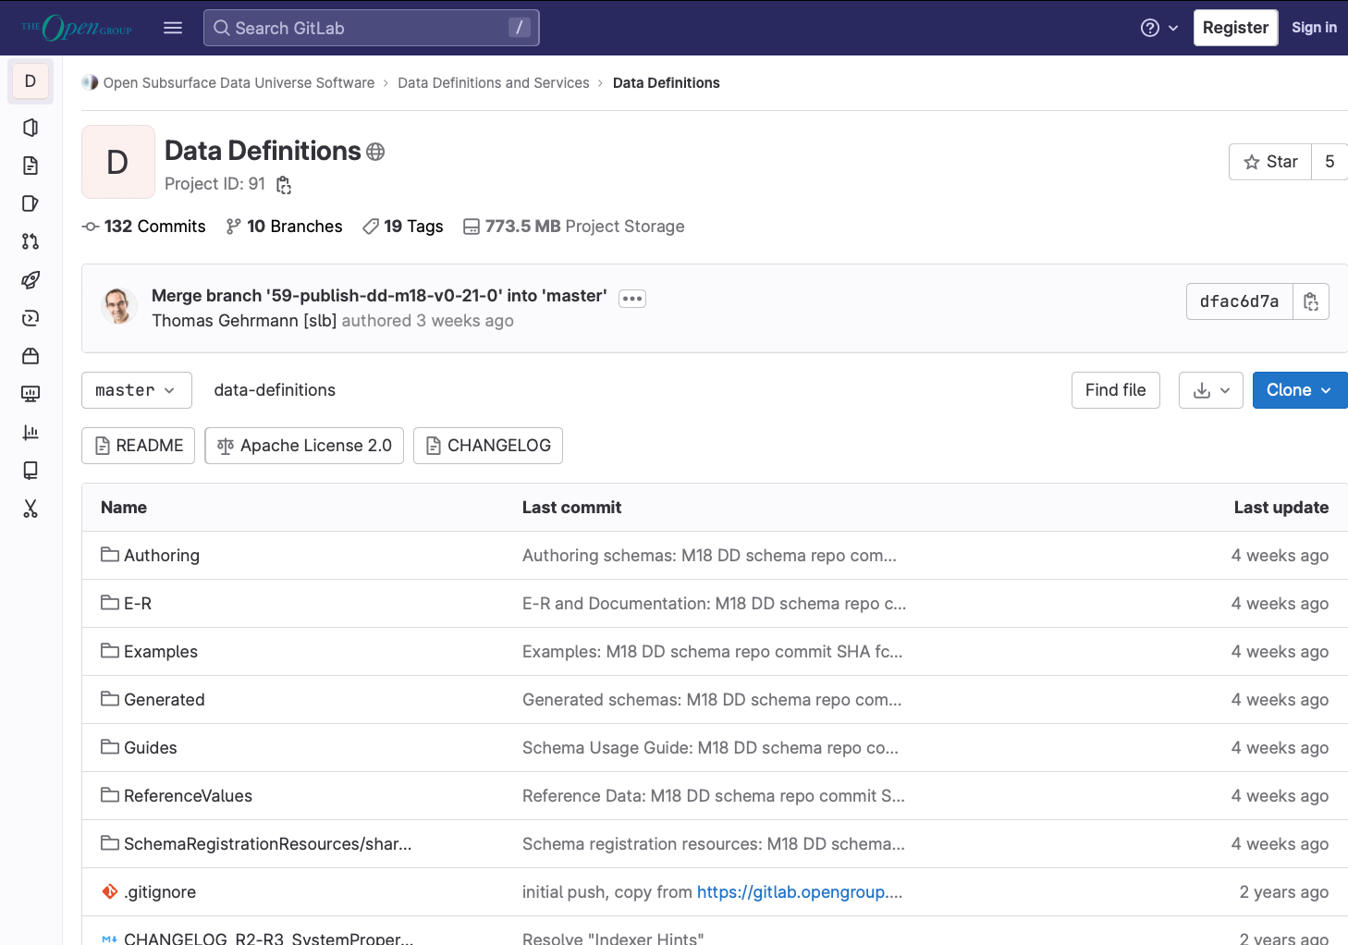
OSDU Data Concepts (prev known as definitions)
OSDU Data Concept

Slide 26
DEMO
Versioning
Find schema definition
Guides
OSDU Data Concept

Slide 27
Is it possible to do versioning?

Slide 28
How can I find my data?

Slide 29
Core services
Entitlements
Workflow
Search
File
Schema
Indexer
Notification
Partition
Register
Storage
Legal

Slide 30
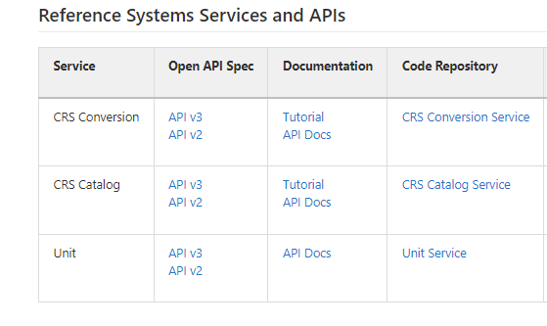
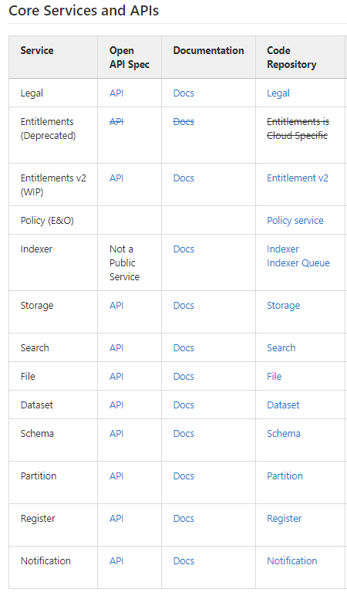
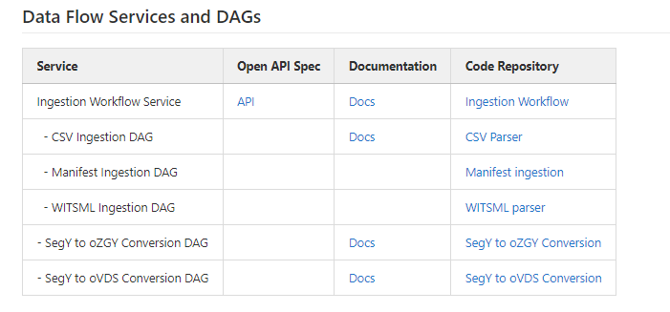
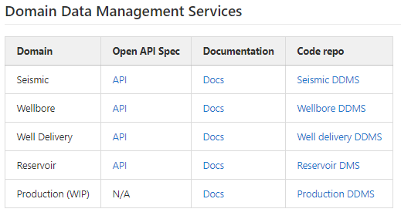
OSDU APIs
High level

Slide 31

DON’T
PANIC

Slide 32
Concepts
OSDU Data Platform
Core services
Security
Ingestion
Domain Data Management Services
OSDU Data Concepts
Data structure
Master data
Work Product Components
Reference data
Schemas

Slide 33
OSDU Data Concepts

Slide 34
Data principles
We value all data
Minimize friction on Data Loading and Ingestion
Don’t forget what you already know
All raw data is preserved
Data are immutable
We use data securely and responsibly
Data are access controlled
Data are governed for right of use
Data has a clear ownership
We embrace minimal viable governance
Data are globally identifiable
Data are discoverable
Data are consumable
We establish, monitor and continuously improve the quality of data
Optimize schema and quality on consumption
Improved data are new data
Data lineage is tracked

Slide 35
Working Group Structure
Core Concepts
PPDM Integration & Reference Data
Test Data
Documents
Geochemistry
Petrophysics
CCS
Production
Reservoir Modeling
Reservoir Management
Renewables
Well Delivery
Seismic

Slide 36
OSDU group type
Master Data
Objects created by a company’s business processes
Single version of truth – Well Known Entity
Work Product Component
Output of a business object (master data)
Are measurements or observations from the object,
Reference Data
Often “type” concepts
Often defined outside of the company, e.g., by standards organizations
Object is versioned; identity is not
Describes a physical object, or business activity
Catalog of objects grows and changes slowly
Or derivatives and interpretations of these outputs
Are immutable and typically not versioned
There is no authoritative record, but preferred
Have associated artefacts
Maybe one of three governance levels:
FIXED - may not edit or add values
OPEN - may add, but not edit existing values
LOCAL - may add and/or edit any values
Section 2, OSDU Schema Usage Guide
Demystifying Well Known Schema/Entity
Notes:
Data type proposals must be assigned an OSDU group type, and the group type dictates the degree of specificity and comprehensiveness needed for the definition
These are the primary group types for data modelling activity

Slide 37
OSDU group type
Work Product
Dataset
A set of work product components for ingestion
May comprise multiple different entity types
The “shipping label”
Used for audit purposes
There is only one entity type
Metadata about the location of the data described by a work product component
Could be a binary file, or location in a physical data store
Current data set manifestations are File and File Collections
Specializations of each exist
Section 2, OSDU Schema Usage Guide
Notes:
Data type proposals must be assigned an OSDU group type, and the group type dictates the degree of specificity and comprehensiveness needed for the definition
Work product is unlikely to be affected by data modelling activity
Dataset may be expanded beyond current permutations, but more likely as a Horizon 2 or 3 activity

Slide 38
“Whats in it for me…”

Slide 39

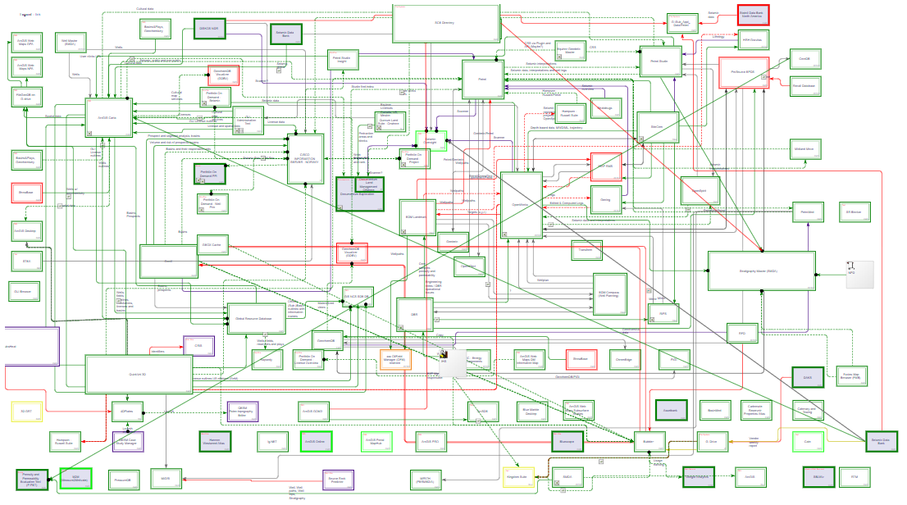
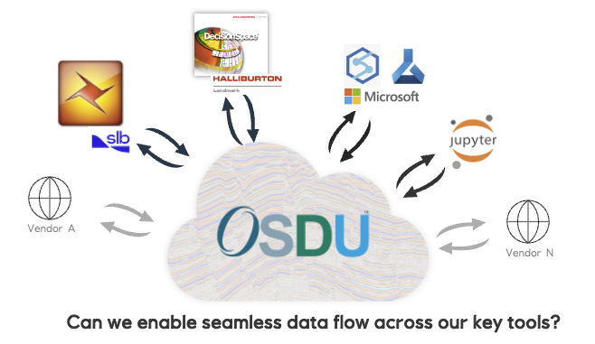
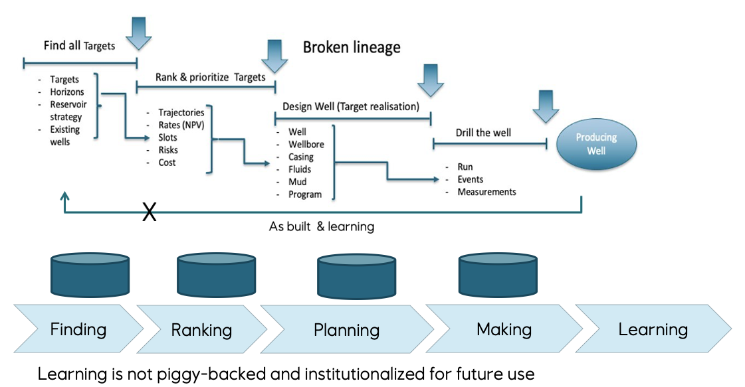
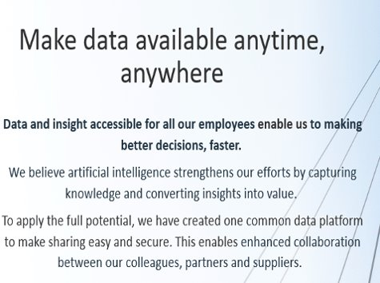
Drivers for OSDU
Boost innovation
Minimize data “locked” in functional silos
Interoperability
Digitalisation require data with known quality
Lack of lineage and provenance
Data needs curation to be valuable
Avoid information loss
Common catalogue and access to data
None can do it alone
Enable industrial automation
Sharing infrastructure development cost
Industrial standardisation
To address

Slide 40
From platform development to solution integration – relative effort
Early days dominated by platform
As the platform become usable, a growing set of solutions emerge
Approaching inflection point where solution development overtake platform
Solution space development will change from creating point solutions to workflow composition and system integration
OSDU Data Platform
OSDU adaption and enabled business solutions
2019
2023

Slide 41
What does it take?
OSDU Success =
Alignment, transparency and
co-operation
OSDU Community
Vendors
Equinor
Key observations:
There must be a joint situational perspective for the area to standardize.
There must be assumed business opportunities in several dimensions for this to work.
E.g. Operators, Service/SW providers and cloud providers.
Transparency and openness within forum is a make or break
Operators (as main customers) involvement and contributions in the OSDU community is key.
Equinor very active in OSDU Community.
OSDU Sponsors: Harald Laastad & Oddvar Vermedal
OSDU Advisory Group: Harald Laastad & Oddvar Vermedal
Equinor focal-point: Einar Landre
OSDU Management Committee: Equinor (Øivind Berggraf) ,TotalEnergie, Shell, BP, XON,
OSDU Chair: Chevron
5-10 resources continuously involved in different parts of community. Spans SMEs, Data engineers, SW architects and others from different parts of Equinor.
Operators like Equinor needs to have focus on developing the new market and from time to time seed fund application and service vendors.
OSDU is a key strategic bet in Equinor´s digitalization and cloud journey
Equinor have an internal OSDU DevOps team (8-10 persons) continuously working on utilising OSDU in Equinor.

Slide 42
The OSDU journey
2022 and beyond
Increased commercial solution focus: Cloud Service and app/solution providers.
Continuous development of new OSDU capabilities.
Seismic, Wells, Reservoir, Rock & Fluid, Production, Real-time, New Energy, ….
Initial operational deployments in many O&G companies.
Equinor, ExxonMobil, Shell, Chevron, TotalEnergie, BP, Petrobras, WinterShall DEA, …
2020-2021:
OSDU Mercury – development of first commercial release.
Implemented on Microsoft, AWS, Google and IBM/RedHat
2018-2019:
Shell invites O&G companies to join forces to drive the development of an Open Source Data Platform for Upstream O&G and donates Shell Data Universe (SDU) code as a kick start.
OSDU founded in September 2018 as an Open Group Forum. Many ISV’s and tech companies joins and new are still joining
July 2019: SLB donates DELFI data services. Refactoring Shell+SLB code really kicks-off.
– 2017:
Increased focus on digitalisation, data and new value from data
O&G cloud transition begins.

Slide 43
Questions?

